Slide 1

RPA Heat Maps

Slide 2
RPA Opportunities in the Finance Function
Finance Functions
Accounts Payable
Accounts Receivable
Fixed Assets
Travel and Expenses
Cash Management
General Accounting
Receive Invoice
Processing of Sales Orders
Work Order Creation
Expense Processing (General)
Manage Business Advances
Journal Entries
Financial statement analysis
Approve Invoice
Credit Control
Asset Movement
Expense Processing (Leadership)
Pretty Cash Accounting
Trial balance preparation, review
Financial and regulatory reporting
Release Invoice
Debtors Management (B2C)
Asset Ageing Analysis
Open Purchase Orders
Petty Cash Management
Account reconciliation
Perform Vendor Reconciliations
Debtors Management (B2B)
Dispose Assets (Accounting only)
Manage T/E Reporting
Manage Expense Reimbursement
Intercompany accounting
Perform Spend Analysis
Collection Accounting
IFRS Adjustments
Statutory / GAAP adjustments
Managing Queries (English Language)
Period-end Procedures
Period End Close
Low RPA Opportunity
Medium RPA Opportunity
High RPA Opportunity

Slide 3
RPA Opportunities in the Human Resources Function
Selection of Human Resource Functions
Learning & Development
Organization Mgmt.
Recruitment
Performance Mgmt.
Employee Lifecycle Mgmt.
Compensation & Benefits
Training Booking
Policies & Procedures
Recruitment
Planning
Goal & Objective Setting
Contract
Mgmt.
Compensation Benefits Strategy
Administer Employee Benefits
Registers &
Record Booking
Change
Mgmt.
Candidate Sourcing
Performance Appraisals
Employee Relationship Admin
Salary Survey
Manage Payroll
Personal Development Plans
Organization Survey Mgmt.
Candidate Screening & Assessment
Succession Plans
Employee Master
Data
Strategic Survey
Perform Employee Data & Salary Admin
Develop & Train Workforce
Health & Safety
New Joiner Hiring
Talent Mgmt.
Leave & Absence Admin
Strategic
Procurement
Retention
Internal Communication
New Joiner On boarding
Employee Self-
Service Mgmt.
Compensation Plans
Exit Admin
Benefit Schemes
Low RPA Opportunity
Medium RPA Opportunity
High RPA Opportunity

Slide 4
RPA Opportunities in the Information Technology Function
Selection of Information Technology Functions
Manage Information Technology
Service Portfolio Mgmt.
Service Transition
Service operations
IT Products & Services
Mgmt.
Data Security & Operations Mgmt.
Service Catalogue Mgmt.
Change Mgmt.
Service Desk
Security Mgmt.
IT Operations Mgmt.
User Relationship Mgmt.
Service Level Mgmt.
Release &
Deployment Mgmt.
Event Mgmt.
Service Continuity Mgmt.
IT Vendor Relationship Mgmt.
IT Business Unit Mgmt.
Lifecycle Mgmt.
Configuration &
Asset Mgmt.
Incident Mgmt.
Access Mgmt.
IT Architecture Mgmt.
IT Disaster
Recovery Planning
Bill Calculation &
Invoicing
Service Testing & Acceptance
Availability Mgmt.
Problem Mgmt.
Support & Train Users
IT Strategy
Knowledge Mgmt.
Capacity Mgmt.
Service Reporting
Request Fulfilment
Risk & Compliance Mgmt.
Low RPA Opportunity
Medium RPA Opportunity
High RPA Opportunity

Slide 5
RPA Opportunities in the Banking Front Office Function
Banking Front Office Functions
Client Onboarding
Marketing & Development
Brokerage
Trading
Advisory
Research
Relationship Mgmt.
Lead Mgmt.
Market Research
Securities Lending
High Touch Trading
M&A Advisory
Economic Research
Client Relationship
Mgmt.
Referral Mgmt..
Prod. Design & Maintenance
Reporting &
Technology
Electronic Trading
Debt & Equity Underwriting
Credit Research
Life Event
“Trigger Mgmt.”
Upfront Education / Corresp.
Marketing
Risk Mgmt. & Financing
Structured Trading
Corporate Advisory
Equity Research
Institutional Sales
Prospect Profiling / Qualification
Securities, Collateral & Derivatives
Financial Planning
Customer Mgmt.
Client Data / Account Maintenance
Client Profiling
Securities, Collateral & Derivative s Mgmt.
Over-the-counter Derivatives
Wealth Planning / Structuring
Customer Data Mgmt.
Customer Contact Response
Additional Products & Services
Product / Service Enrollment
Mandatory Corporate Actions & income Processing
Exchange Traded Derivatives
Investment Solutions
Customer Record Administration
Customer ID &
Verification
Product Marketing
Voluntary Corporate Actions
Collateral Margin Mgmt.
Banking Solutions
Customer Account Administration
Customer
Relationship Mgmt.
Securities Settlement
Securities Custody
Credit Solutions
Customer Service
Securities Transaction Processing
Low RPA Opportunity
Medium RPA Opportunity
High RPA Opportunity

Slide 6
RPA Opportunities in the Banking Middle Office Function
Banking Middle Office Functions
Banking Transactions
Risk Mgmt.
Investment Transaction
Treasury
Institutional Requirement
Finance & Reporting
Compliance
Cards
Market Risk
Discrete Asset Mgmt.
Capital Mgmt.
Plan Conversions
Statements
Surveillance
Loans
Credit Risk
Confirmation
Liquidity
Mgmt.
Plan Distribution
Approvals
Mgmt.
Reporting
Testing
Checking
Operational Risk
Transact. Lifecycle
Events
Asset-Liability Mgmt.
Client Service Mgmt.
Ongoing Service
Corresp.
Control Compliance
Mortgages
Cash & Trade Finance
Trade / Order Mgmt.
Investment Administration
Payroll Processing
Finance Control
Wires / ACH
Cash & Liquidity Mgmt.
Prospectus Delivery
Fund Administration
ERISA Compliance
Client Reporting
Bank / MM Sweeps & Redemptions
FX Processing
Integrated Middle Office
Traditional
Alliance Partner
Mgmt.
Deposits
Payment Services
Trade Control Services
Web Bill Pay
Precious Metals,
Physical
& Bank Notes
Lifecycle Control
Services
Trust / Family Office Services
Trade Finance
Processing
Data Control Services
Low RPA Opportunity
Medium RPA Opportunity
High RPA Opportunity
Structured Finance Processing
Trial Balance Services

Slide 7
RPA Opportunities in the Banking Back Office Function
Banking Back Office Functions
Clearing, Settlement & Custody
Risk Mgmt.
Books & Records Mgmt.
Technology
Financial Mgmt.
Client & Tax Servicing
Trade Clearance
Sales Supervision
Client Accounting
Operations Technology
Fees & Billing
Client Asset & Liability Reporting
Securities Settlement
Credit Risk Mgmt.
Trust Accounting
Technology Infrastructure
P&L
Institutional Custody Account
& Reporting
Cash Settlement
Fraud Mgmt.
Portfolio Accounting
Tech. Support
Balance Sheet
Client Tax Reporting
Dividends, Interests & Corporate Actions
Product Supervision
Reconciliation
IT Strategy
Compensation
Client Tax Claims
Custody / Safekeeping
Margin / Collateral
Pricing / Product Reference Data
Firm wide Systems
Regulatory Reporting
Regulatory Tax
Proxy
Channel Mgmt.. & Products & Services
Product
Sub-Accounting
Client Servicing
Transfer Agency
Delivery Channel Mgmt.
Account Carriers
Payments
Products & Services Development
Market Products & Services
Low RPA Opportunity
Medium RPA Opportunity
High RPA Opportunity

Slide 8
RPA Opportunities in Insurance – Core Functions
Insurance – Core Functions
Product & Distribution
Quoting & Underwriting
Policy Servicing
Claims
Risk, Capital & Investment Mgmt.
Develop & Manage Products-Services
Market & Promote Products-Services
Process Submissions & Renewals
Bill & Collect Premiums
Provide Customer Service
Manage Benefits & Claims
Manage Investments
Analyze Market & Determine Customer Needs
Advertise / Promote Products & Services
Calculate & Present Quote
Produce Bill / Statements
Develop Customer Service Strategy
Determine Loss Control
Manage Claim Department
Manage Portfolio
Enhance Existing Products & Services
Manage Products & Services Pricing
Underwrite
Application
Manage Changes to Payment
Details/Plan
Fulfil Customer
Service Requirements
Determine Salvage - P&C Only
Determine Reinsurance
Perform Investment Accounting
Monitor / Manage Products & Services Programs
Manage / Support Distribution Channels
Manage Application / New Business
Process Receipts
Facilitate Revenue Enhancement (e.g.: Cross Sell, Up sell)
Perform Reporting
Determine Subrogation – P&C Only
Process Transactions
Withdraw Products & Services
Develop Marketing & Sales Plan
Deliver Policy
Perform Collection
Manage Customer Service Delivery
Evaluate Fraud
Manage Exposure
Monitor Assets
Develop New
Products & Services
Manage the Selling Process
Renewals
Measure & Improve Customer Service
Perform Constituent Set Up
Manage Claim Reserves
Perform Private
Asset Origination
Launch New / Enhanced Products
& Services
Perform Agent
Setup
Manage Customer Relationships
Manage Policy Servicing
Manage / Review Billing
Manage Litigation
Select Assets
Plan Changes to Products & Services
Manage
Endorsements
– P&C Only
Receive Claim
Notice
Manage Vendor Relationships
Manage Commissions
Initial Claim Setup
Negotiate & Settle Claims
Manage Commission Types & Plans
Negotiate
Commission
Triage / Assign Claim
Issue Payment
Payout Commission
Low RPA Opportunity
Medium RPA Opportunity
High RPA Opportunity
Perform
Investigation
Perform Claims Audit

Slide 9
RPA Opportunities in Insurance – Shared Services
Insurance – Shared Services
HR Function
Finance¹
IT Function
Organization Mgmt.
Recruitment
Accounts Payable
Service Portfolio Mgmt.
Service Transition
Service operations
Plan & Manage
Employee Resources
Manage Recruiting & Employee Integration
Accounts Receivable
Service Catalogue
Mgmt.
Change Mgmt.
Service Desk
Security Mgmt.
Employee Lifecycle Mgmt.
Compensation & Benefits
Cost Mgmt.
Service Level Mgmt.
Release &
Deployment Mgmt.
Event Mgmt.
Service Continuity
Mgmt.
Manage Employee
Union Activities
Administer Employee Benefits
Fixed Asset Accounting
Lifecycle Mgmt.
Configuration &
Asset Mgmt.
Incident Mgmt.
Access Mgmt.
Monitor Employee
Health & Safety
Manage Payroll
General
Ledger Accounting
Bill Calculation &
Invoicing
Service Testing & Acceptance
Availability Mgmt.
Problem Mgmt.
Manage Employee Separation Process
Perform Employee
Benefit & Enrolment
Budgeting / Forecasting
Knowledge Mgmt.
Capacity Mgmt.
Service Reporting
Learning & Development
Perform Employee
Data & Salary Admin
Tax Accounting
Request Fulfilment
Risk & Compliance
Mgmt.
Develop & Train
Workforce
Bus. Financial
Analysis &
Reporting
Change Mgmt.
¹Only L1 processes available for Finance
Reporting
Low RPA Opportunity
Medium RPA Opportunity
High RPA Opportunity

Slide 10
RPA Opportunities in Public Sector (Federal) – Finance (1/2)
Public Sector (Federal) – Finance Services
Manage Funding
Manage Planning, Budgeting, Forecasting & Internal Reporting
Manage Accounting and External Reporting
Policies & Procedures
Manage Revenue & Accounts Receivable
Prepare ARLU
Conduct Strategic Planning
Conduct Gs & Cs
Planning
Maintain Financial Authorities and Delegations
Prepare Financial Statements
Develop and Maintain Policies & Procedures
Manage Revenue, Receivables and Receipts
Prepare Main/ Supplementary Estimates
Develop and Maintain
PMF
Prepare Organizational Budgets & Forecasts
Manage GL & Chart of Accounts
Prepare Public Accounts Plates
Monitor Adherence to Policies & Procedures
Manage Overdue Receivables
Prepare MC’s and TB Submissions
Conduct Integrated Operational Planning
Monitor Performance
Manage Vendor Master Data
Prepare RPP & PAA
Provide Policy Interpretation and Advice
Manage Interdepartmental Settlements
Conduct Investment Planning
Manage Forecasting & Budget Review
Manage Customer
Master Data
Prepare DPR
Manage Expenditures, Payables & Payments
Cost Management
Reallocate Budgets
Manage Accounting and Financial Close
Maintain MAF
Receive Goods or
Services
Manage Travel
& Expense Claims
Manage Acquisition
Cards
Manage Payables
Manage Other Payments
Manage Payments
Manage Post Payment Verification
Low RPA Opportunity
Medium RPA Opportunity
High RPA Opportunity

Slide 11
RPA Opportunities in Public Sector (Federal) – Finance (2/2)
Public Sector (Federal) – Finance Services
Asset Management
Procurement- Acquisition Strategy
Manage Enablers
Manage Risk and Control
Procurement Execution
Capital Asset Planning
Develop and Update Procurement Plan
Develop and Maintain Financial Systems and Processes
Maintain Corporate
Risk Profile
Test Operating Effectiveness of Internal Controls
Acquire Goods with Acquisition Cards
Administer Contract
Asset Procurement
Develop Strategies for Category Sourcing
Provide Training & Offer Development Activities
Monitor Key Risks
Manage Audits
Acquire Goods
Develop SRCL and/or Waiver
Asset Receiving and Tagging
Develop Procurement Vehicles for Strategic Planning
Talent Management & Succession Planning
Maintain Internal Control Documentation
Manage Departmental Audit Committee
Acquire Services
Conduct Personnel Security Screening
Asset Additions
Execute Sourcing
Strategy
Conduct Performance Management Activities
Liaise with PWGSC
Maintain Contracts Database
Capital Asset
Amortization
Manage Organization & Governance Activities
Asset Monitoring
Data Analytics
Asset Disposal
Low RPA Opportunity
Medium RPA Opportunity
High RPA Opportunity

Slide 12
RPA Opportunities in Public Sector – Human Resources (1/2)
Public Sector – Human Resources Services
Manage Recruitment
Manage New Hire Integration
Plan & Manage Human Resources
Manage Labor Relations
Manage Employee Relations
Develop Rec. Processes & Tools
Withdraw Job Offer
Manage HR Strategy & Objectives
Develop Org Effectiveness Strategy
Understand Legal & Reg. Environment
Manage Capability Cases
Create/Edit Job Requisition
Manage New Hire
Manage Organizational
Design
Develop Policies and Procedures
Develop Global
ER/LR Policies
Manage Performance Cases
Close Job Requisition
Manage On-boarding
Manage Workforce Planning
Input to Business Planning
Manage Unions / Work Councils
Manage Grievance Cases
Manage Referral Process
Monitor Probation Period
Develop Reward Strategy
Provide HR Insights
Manage Collective
Agreements
Manage Appeal Cases
Source Candidates
Manage Organization Design
Develop Benefit Strategy
Business Demand Capture
Manage M&A & Divestures
Service Management
Screen Candidates
Manage Organization
Develop Talent Strategy
Develop Performance
Strategy
Manage Reporting
Select Candidates
Manage Locations
Manage Positions
Manage Org Development: Organizational Strategy
Manage Services Quality & Governance
Manage Agency Worker Recruitment
Manage Organizational Hierarchy
Create Position
Defining OE Tools & Approaches
Deliver Organizational
Change
Manage HR Information
Manage Job Offer
Manage Job/ Job Families
Update Position
Develop Change
Management Frameworks
Define Roles &
Competencies
Close Position
Low RPA Opportunity
Medium RPA Opportunity
High RPA Opportunity

Slide 13
RPA Opportunities in Public Sector – Human Resources (2/2)
Public Sector – Human Resources Services
Manage Performance
Manage Learning & Development
Manage Talent
Administer Absence & Health
Manage Compensation
Payroll
Design Performance Process & Tools
Conduct Mid-Year
Review
Design Learning Strategy & Tools
Develop Talent Process & Tools
Manage Sickness
Absence
Gather Industry Compensation Comparisons
Process Trial Payroll
Manage Competencies
Conduct Annual Review
Assess Competency & Learning Needs
Develop Succession
Plan
Record Short term Sickness
Design Reward Plans
Reconcile Trail Payroll Run
Create Team Goals &
Dev. Ind. Objectives
Manage Performance Improvement
Develop Learning Programs
Conduct Talent Review & Identify Talent
Record Long Term Sickness Absence
Analyze & Evaluate
Jobs
Process Final Payroll
Administer Employee Changes
Manage Learning Programs
Manage Talent Network
Administer Occupational Health
Manage Annual Compensation Review
Reconcile Final Payroll
Change Work
Schedules
Man. Promotion, Demotion, & Lateral Moves
Deliver Learning Programs
Develop Engagement Surveys
Manage Return to Work
Notify employee of Compensation
Process Payroll Reports
Administer Mass Data Changes
Receive & Resolve HR Queries
Evaluate Training Costs
Implement & analyze Surveys
Manage Flexible Working
Manage Allowance
Process and Distribute Net Pay
Change Employee Personal Data
Manage Personnel Files
Assess & Manage Learning
Manage Diversity
Administer Annual Leave
Manage Quarterly
Comp. Forecasting
Process and Distribute Pay slips
Perform Employee Data Admin: Administer Employee Separation
Develop & Manage
Work Life Program
Administer Leave of Absence
Manage Off Cycle
Reward Changes
Post Payroll to General Ledger
Manage Voluntary Exit
Manage Redundancy / Redeployment
Manage Rewards: Manage Benefits
Investigate Payroll Queries
Manage Involuntary
Exit
Conduct Exit Interview & Communications
Gather Industry Benefit Comparisons
Design Benefit Programs
Manage Benefit
Enrolment& Amendments
Manage Exit
Compliance
Manage Compromise Agreement
Process Benefit Costs
Manage Pension Administration
Low RPA Opportunity
Medium RPA Opportunity
High RPA Opportunity

Slide 14
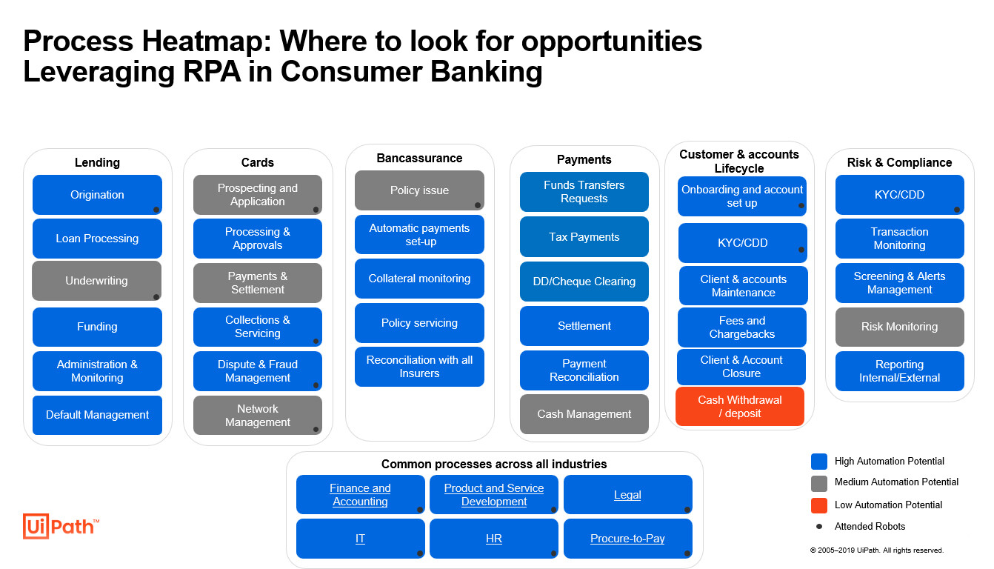

Slide 15
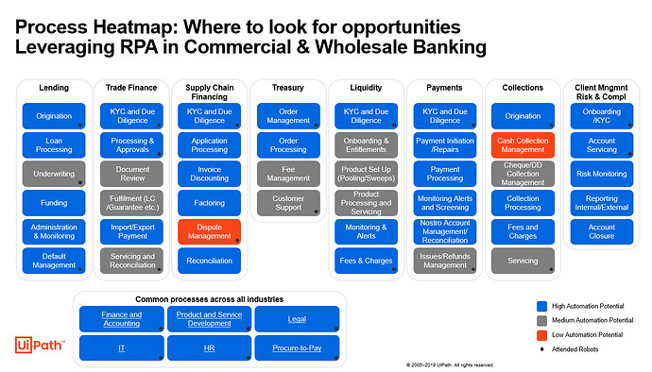

Slide 16
